Slide 1
Lecture 4: Environmental Econometrics
Prof. Theising
Environmental Economics Econ 4075

Slide 2
Moving into Module 2: Measuring Environmental Benefits
Recall from previous lectures: economists’ goal is to maximize social net benefits from environment
Policy can correct market failures, but to do so, must measure and compare costs & benefits
Professional economists spend relatively more time and effort quantifying and monetizing environmental benefits than costs
Any ideas why?

Slide 3
Why Do Economists use Econometrics?
Economic framework + Tricks from statistics = econometrics
Statistical toolkit applied to questions related to problems and phenomena within economics.

Slide 4
Why Do Economists use Econometrics?
Economic framework + Tricks from statistics = econometrics
Statistical toolkit applied to questions related to problems and phenomena within economics.
Often, econometrics has a specific focus on causality
Why such a focus on causality? Correlations are important, too…

Slide 5
Why Do Economists use Econometrics?
Economic framework + Tricks from statistics = econometrics
Statistical toolkit applied to questions related to problems and phenomena within economics.
Often, econometrics has a specific focus on causality
Why such a focus on causality? Correlations are important, too…
We want to know with some degree of confidence that an intervention/policy etc. affects an outcome. Resources are constrained and interventions cost money!
Other times, we may formally model consumers’ utility functions (to measure willingness-to-pay) or firms’ profit functions (to measure marginal costs)
Added structure of the model: counterfactual analysis possible

Slide 6
Econometrics, in General
Experience with econometrics can get you a job! A really good job (where you could improve business decisions), a good pre-doc or research assistantship, etc.
There are amazing resources out there.
Dr. Ed Rubin’s undergraduate econometrics course, machine learning for economists course, and graduate level econometrics course are open source and taught in R.
Dr. Scott Cunningham’s Substack, Journal of Human Resources threads, Podcast, and Causal Inference: The Mixtape book
Dr. Nick Huntington-Klein’s website has a TON of resources on econometrics, methods, causality, and examples with replication
Dr. Patty Champ et al. A Primer in Nonmarket Valuation (PDF version available here for free, and Amazon link here)

Slide 7
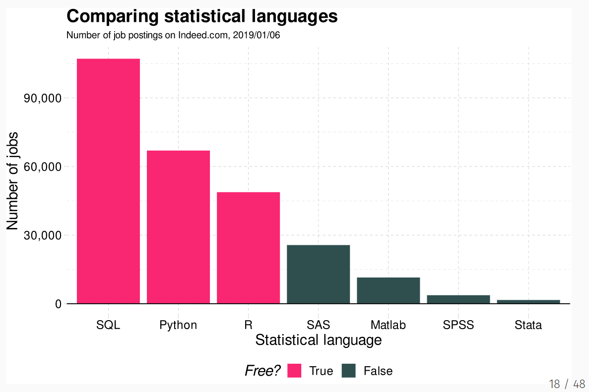
An aside:
Source

Slide 8
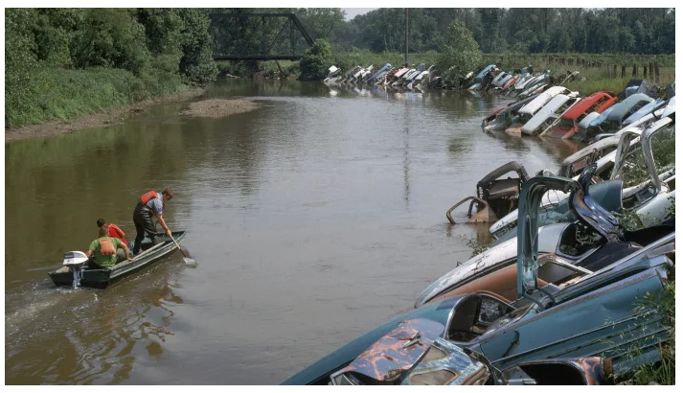
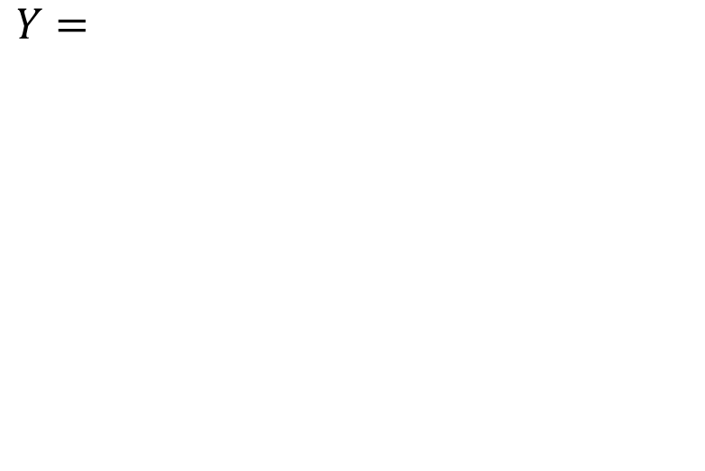
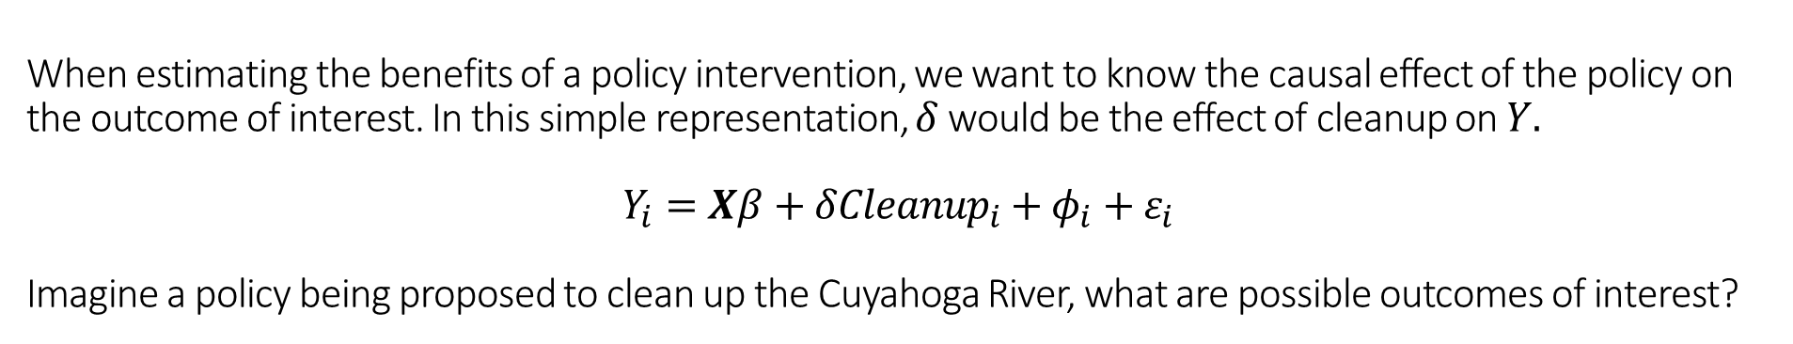
When estimating the benefits of a policy intervention, we want to know the causal effect of the policy on the outcome of interest. In this simple representation, $δ$ would be the effect of cleanup on $Y.$
$$Y_{i}=Xβ+δ{Cleanup}_{i}+φ_{i}+ε_{i}$$
Imagine a policy being proposed to clean up the Cuyahoga River, what are possible outcomes of interest?
$Y=$
Source: history.com

Slide 9
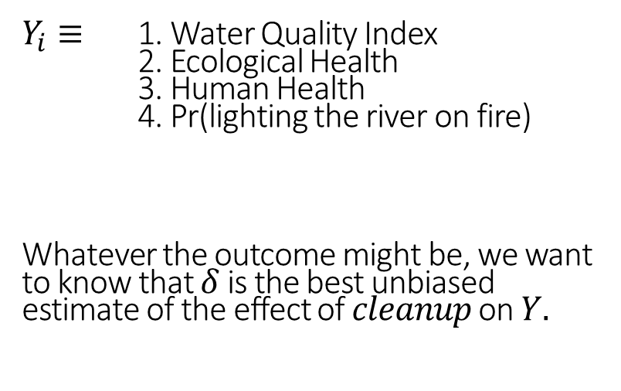
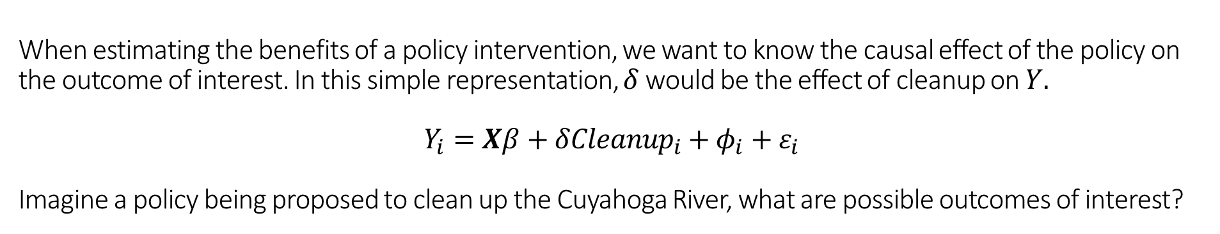
When estimating the benefits of a policy intervention, we want to know the causal effect of the policy on the outcome of interest. In this simple representation, $δ$ would be the effect of cleanup on $Y.$
$$Y_{i}=Xβ+δ{Cleanup}_{i}+φ_{i}+ε_{i}$$
Imagine a policy being proposed to clean up the Cuyahoga River, what are possible outcomes of interest?
$Y_{i}≡$ 1. Water Quality Index
2. Ecological Health
3. Human Health
4. Pr(lighting the river on fire)
Whatever the outcome might be, we want to know that $δ$ is the best unbiased estimate of the effect of $cleanup$ on $Y.$
Source: history.com

Slide 10
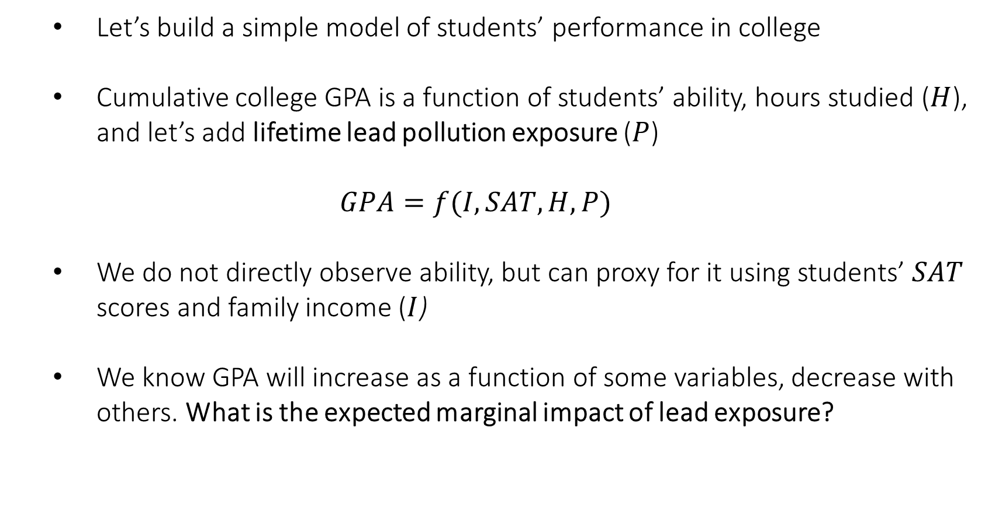
A stylized example (…and review of regression)
Let’s build a simple model of students’ performance in college
Cumulative college GPA is a function of students’ ability, hours studied ($H$), and let’s add lifetime lead pollution exposure ($P$)
$$GPA=f(I, SAT, H,P)$$
We do not directly observe ability, but can proxy for it using students’ $SAT$ scores and family income ($I$)
We know GPA will increase as a function of some variables, decrease with others. What is the expected marginal impact of lead exposure?

Slide 11
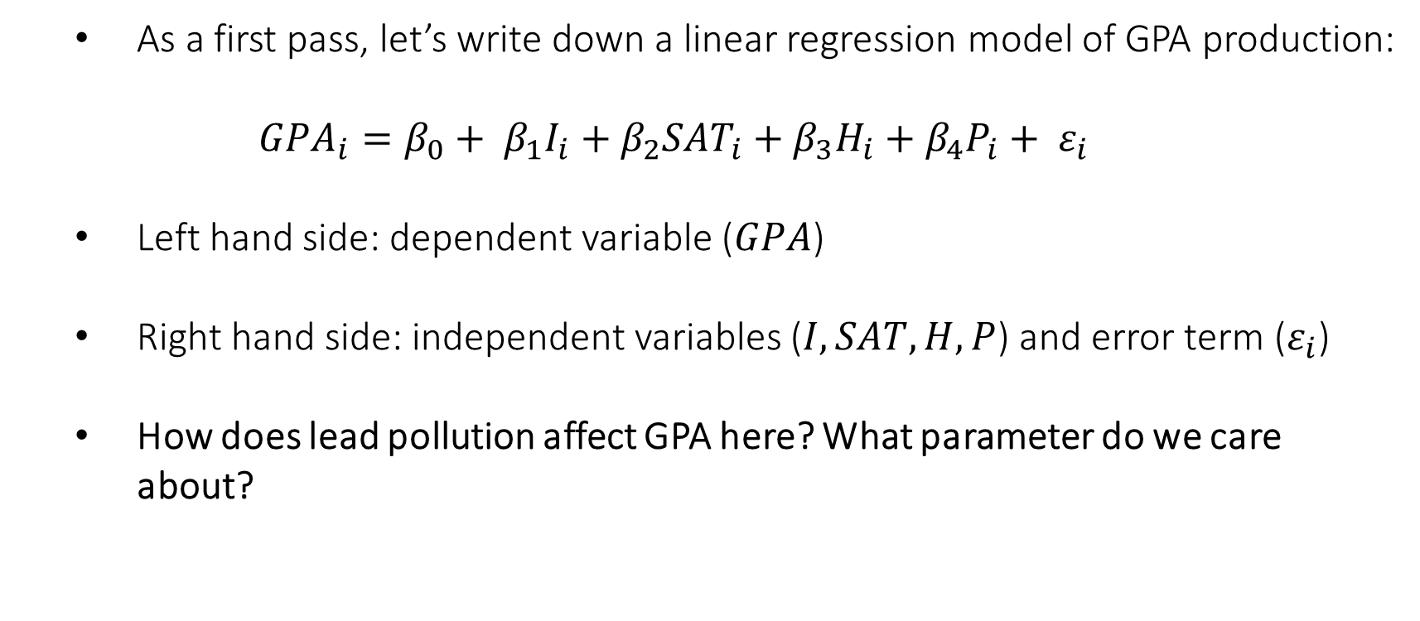
Example (continued…)
As a first pass, let’s write down a linear regression model of GPA production:
$${GPA}_{i}=β_{0}+ β_{1}I_{i}+β_{2}{SAT}_{i}+β_{3}H_{i}+β_{4}P_{i}+ ε_{i}$$
Left hand side: dependent variable ($GPA$)
Right hand side: independent variables ($I, SAT, H,P$) and error term ($ε_{i}$)
How does lead pollution affect GPA here? What parameter do we care about?

Slide 12
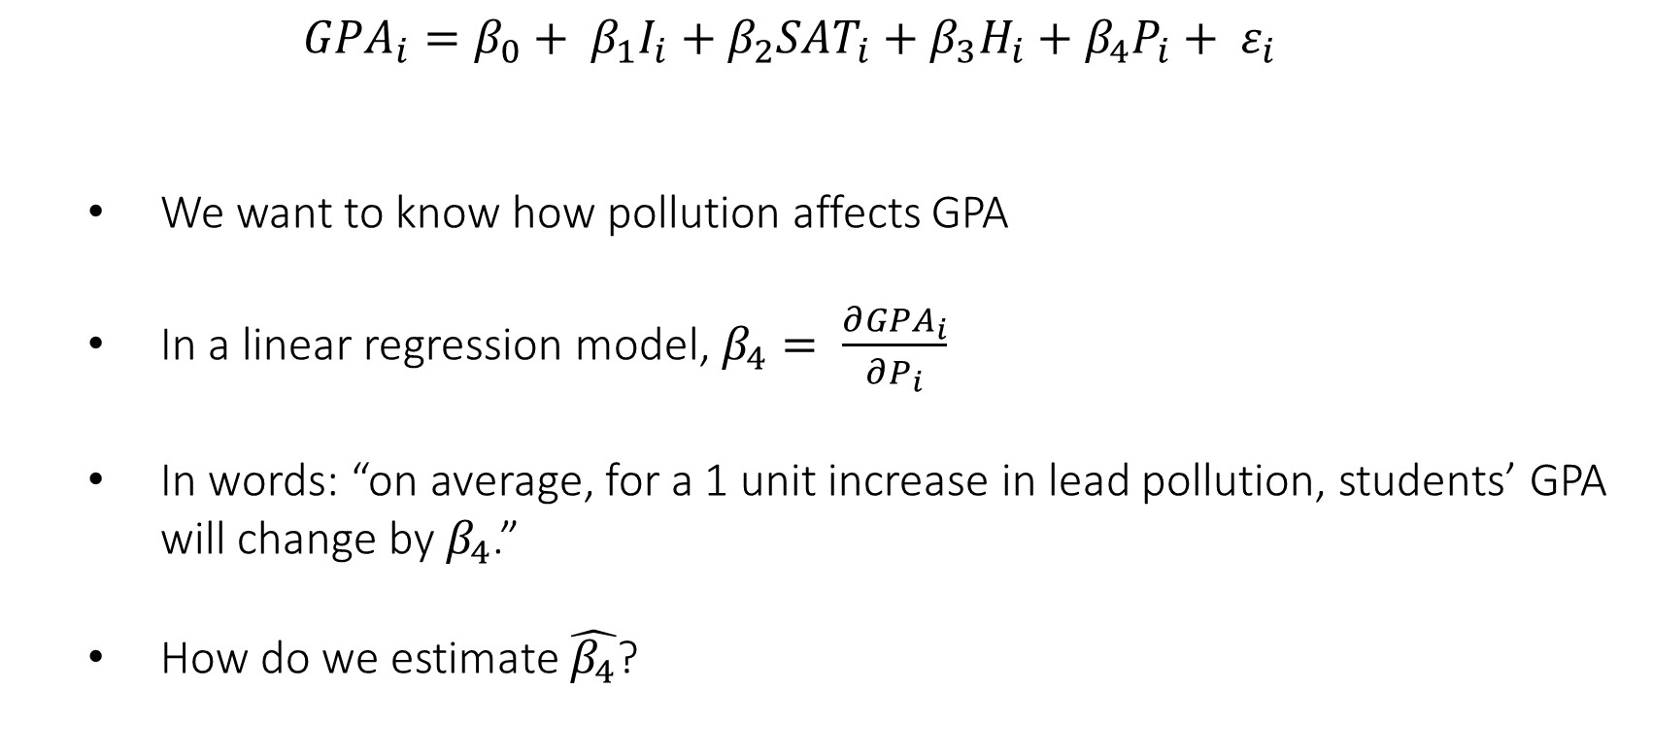
Example (continued…)
$${GPA}_{i}=β_{0}+ β_{1}I_{i}+β_{2}{SAT}_{i}+β_{3}H_{i}+β_{4}P_{i}+ ε_{i}$$
We want to know how pollution affects GPA
In a linear regression model, $β_{4}= \frac{∂{GPA}_{i}}{∂P_{i}}$
In words: “on average, for a 1 unit increase in lead pollution, students’ GPA will change by $β_{4}$.”
How do we estimate $\hat{β_{4}}$?

Slide 13
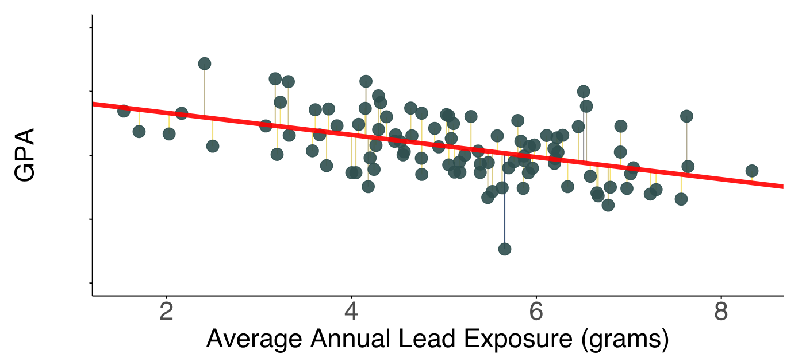
Example (continued…)
Answer: Ordinary Least Squares (OLS)
Recall: the OLS estimate is the combination of $\hat{β}$s that minimizes the SSE

Slide 14

Example (continued…)
So what’s missing?...
$${GPA}_{i}=β_{0}+ β_{1}I_{i}+β_{2}{SAT}_{i}+β_{3}H_{i}+β_{4}P_{i}+ ε_{i}$$

Slide 15
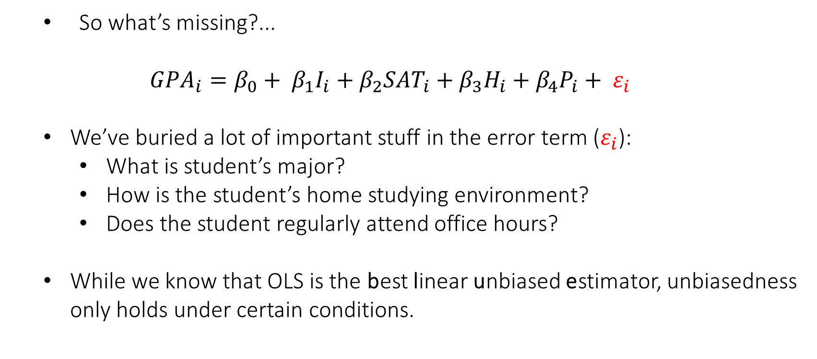
Example (continued…)
So what’s missing?...
$${GPA}_{i}=β_{0}+ β_{1}I_{i}+β_{2}{SAT}_{i}+β_{3}H_{i}+β_{4}P_{i}+ ε_{i}$$
We’ve buried a lot of important stuff in the error term ($ε_{i}$):
What is student’s major?
How is the student’s home studying environment?
Does the student regularly attend office hours?
While we know that OLS is the best linear unbiased estimator, unbiasedness only holds under certain conditions.

Slide 16
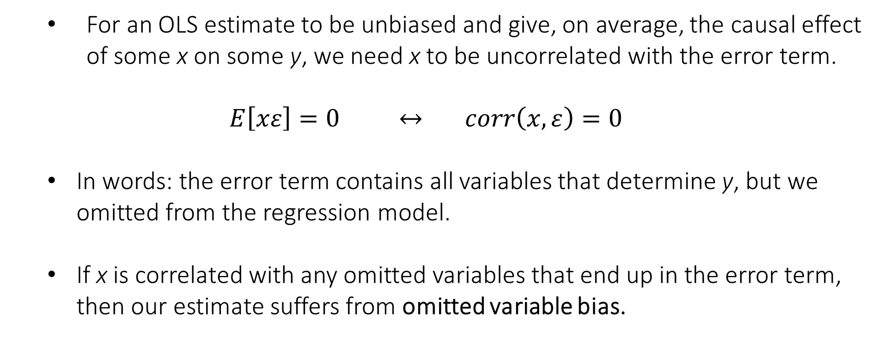
Example (continued…)
For an OLS estimate to be unbiased and give, on average, the causal effect of some x on some y, we need x to be uncorrelated with the error term.
$$E\left[xε\right]=0 ↔ corr\left(x,ε\right)=0$$
In words: the error term contains all variables that determine y, but we omitted from the regression model.
If x is correlated with any omitted variables that end up in the error term, then our estimate suffers from omitted variable bias.

Slide 17
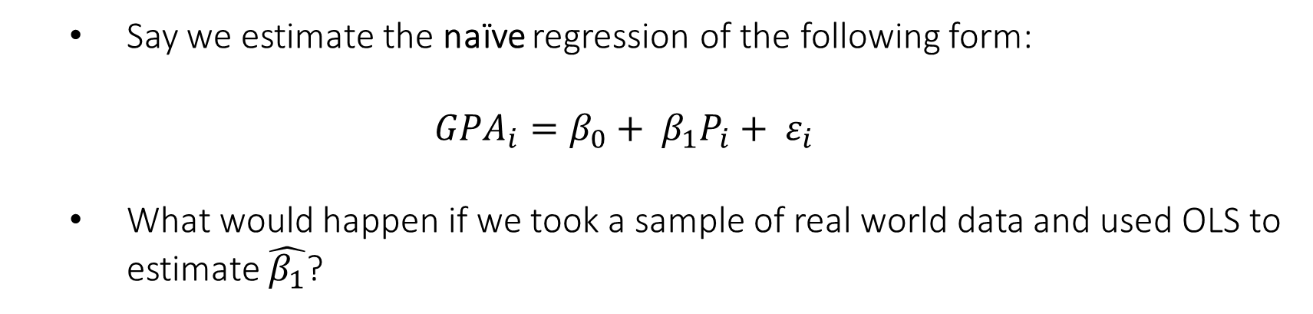
Example (continued…)
Say we estimate the naïve regression of the following form:
$${GPA}_{i}=β_{0}+ β_{1}P_{i}+ ε_{i}$$
What would happen if we took a sample of real world data and used OLS to estimate $\hat{β_{1}}$?

Slide 18
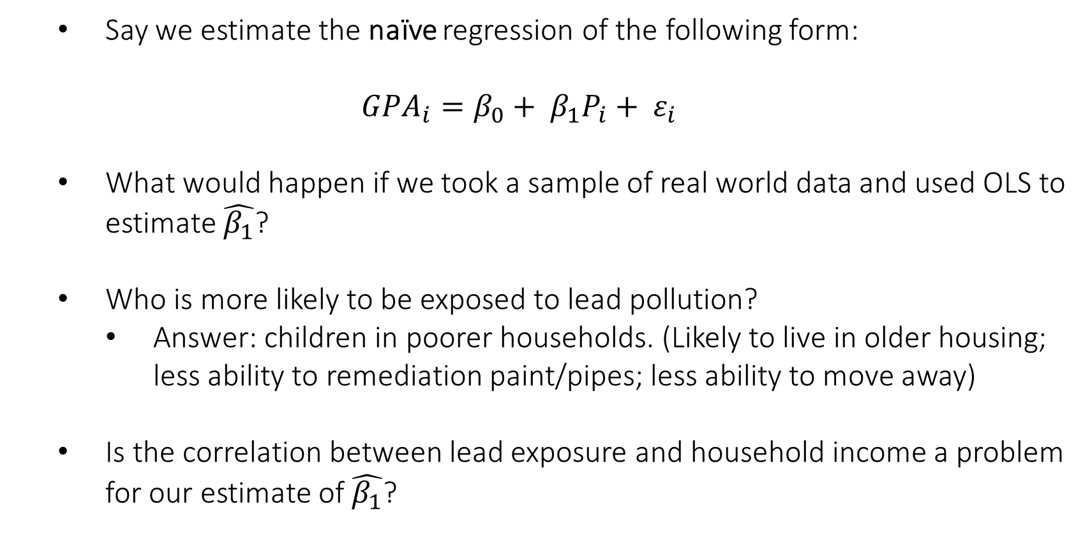
Example (continued…)
Say we estimate the naïve regression of the following form:
$${GPA}_{i}=β_{0}+ β_{1}P_{i}+ ε_{i}$$
What would happen if we took a sample of real world data and used OLS to estimate $\hat{β_{1}}$?
Who is more likely to be exposed to lead pollution?
Answer: children in poorer households. (Likely to live in older housing; less ability to remediation paint/pipes; less ability to move away)
Is the correlation between lead exposure and household income a problem for our estimate of $\hat{β_{1}}$?

Slide 19
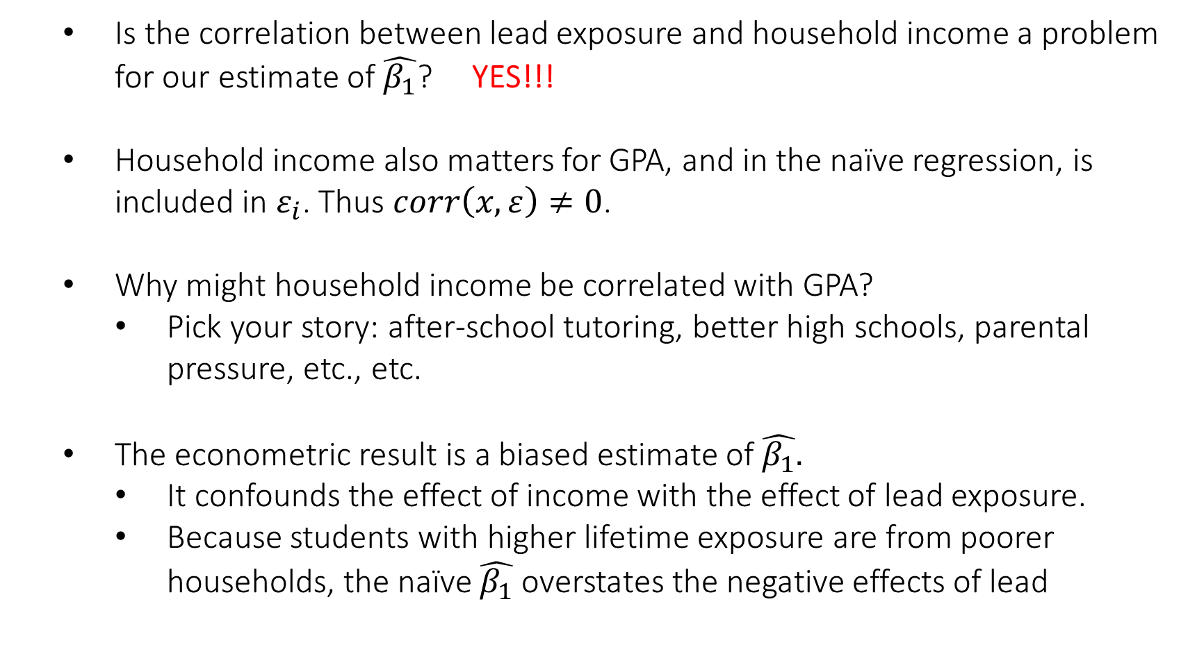
Example (continued…)
Is the correlation between lead exposure and household income a problem for our estimate of $\hat{β_{1}}$? YES!!!
Household income also matters for GPA, and in the naïve regression, is included in $ε_{i}$. Thus $corr\left(x,ε\right)≠0$.
Why might household income be correlated with GPA?
Pick your story: after-school tutoring, better high schools, parental pressure, etc., etc.
The econometric result is a biased estimate of $\hat{β_{1}}.$
It confounds the effect of income with the effect of lead exposure.
Because students with higher lifetime exposure are from poorer households, the naïve $\hat{β_{1}}$ overstates the negative effects of lead

Slide 20
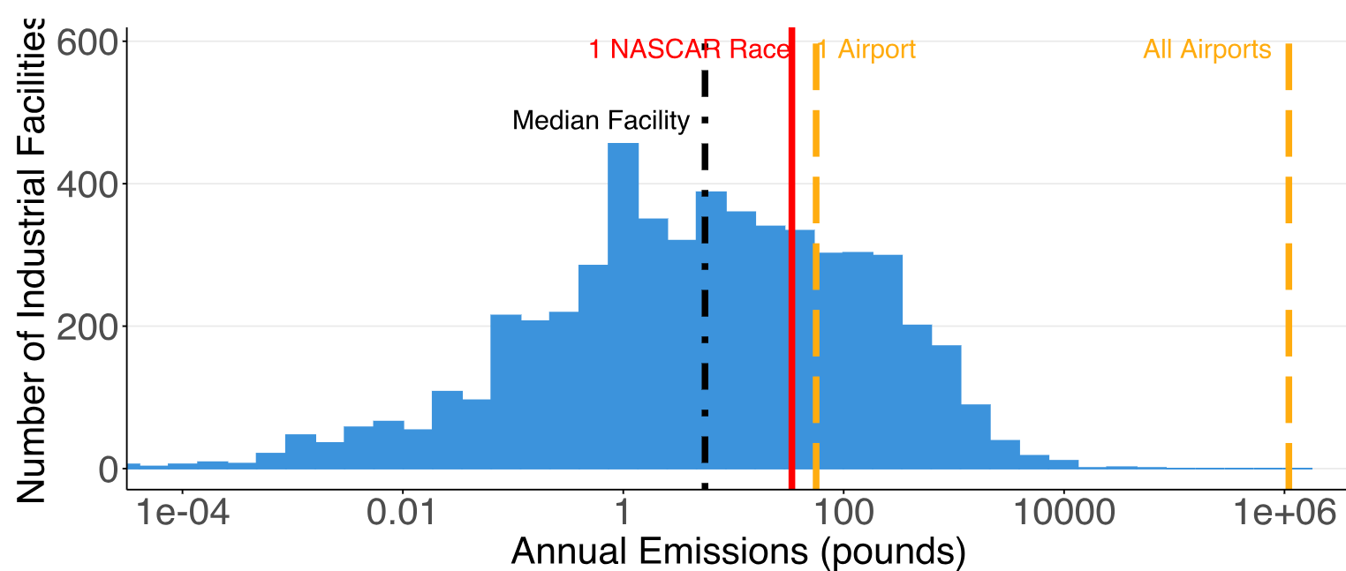
A real world example: lead and education
Prior to 2007, one NASCAR race would result in the ambient emissions of more lead than many industrial facilities’ annual output:

Slide 21
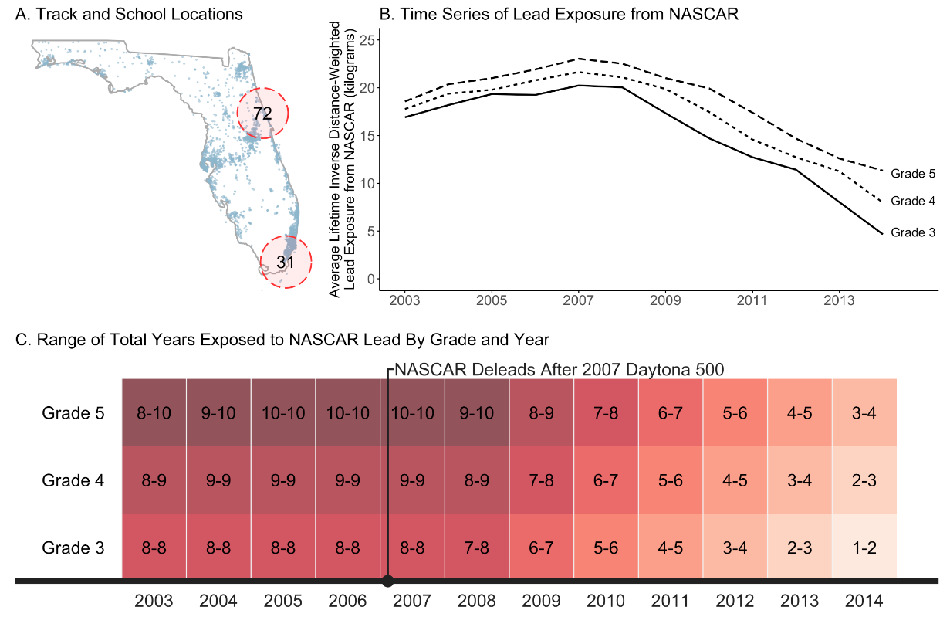
Florida has publicly-available, school-level data

Slide 22
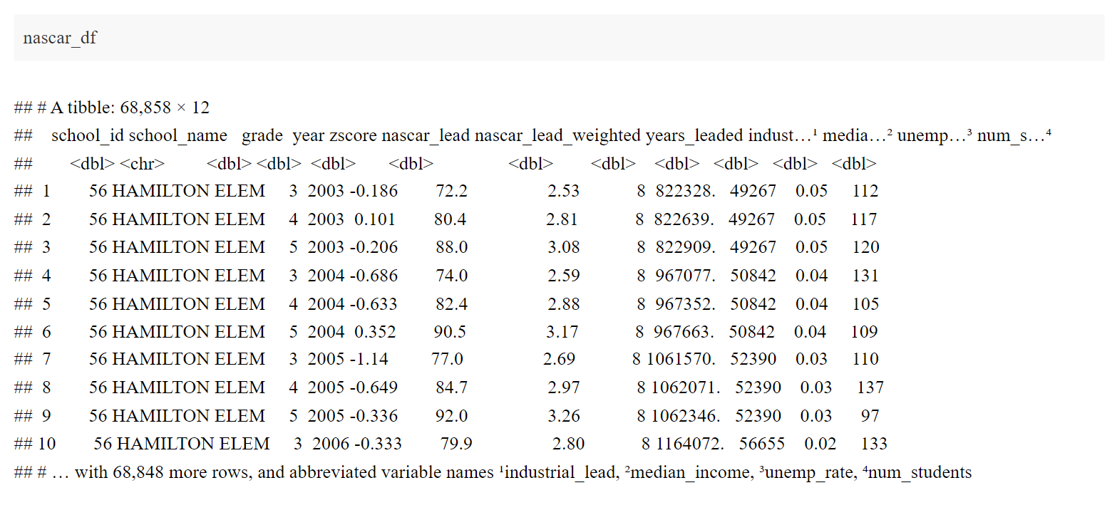
Data: observations are school-by-year-by-grade

Slide 23
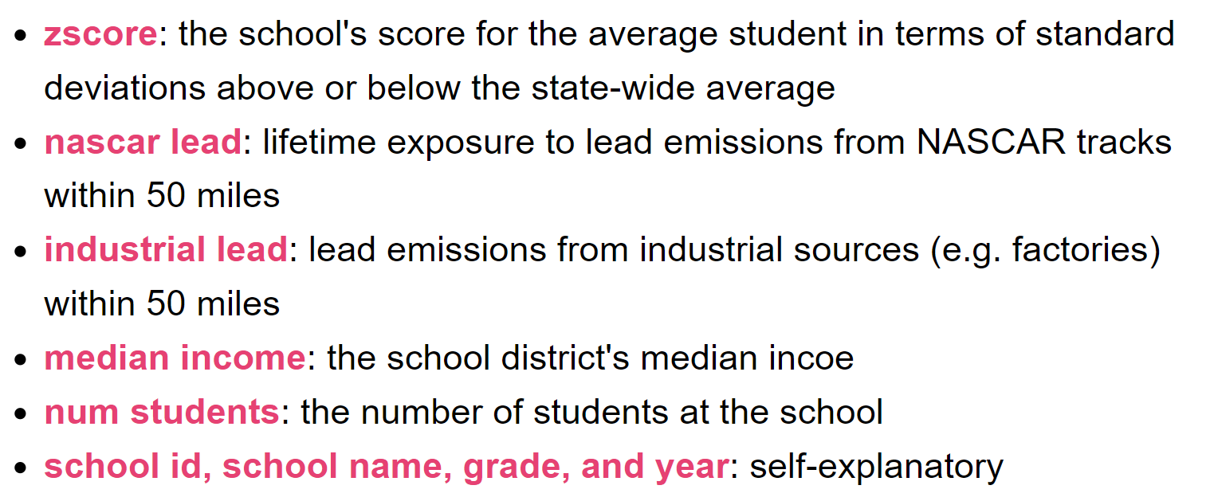
Variables definitions

Slide 24
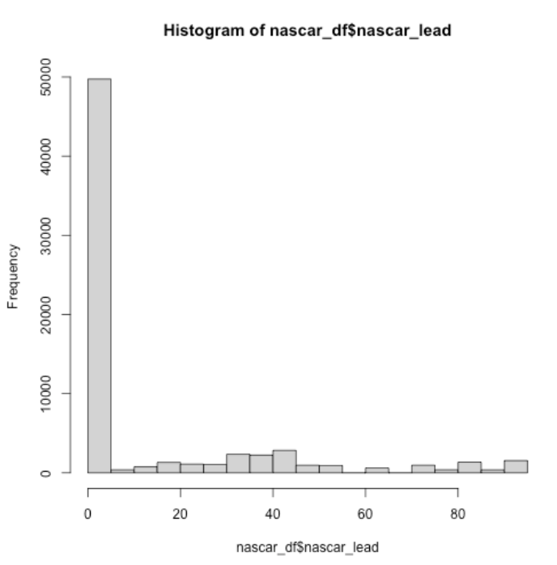
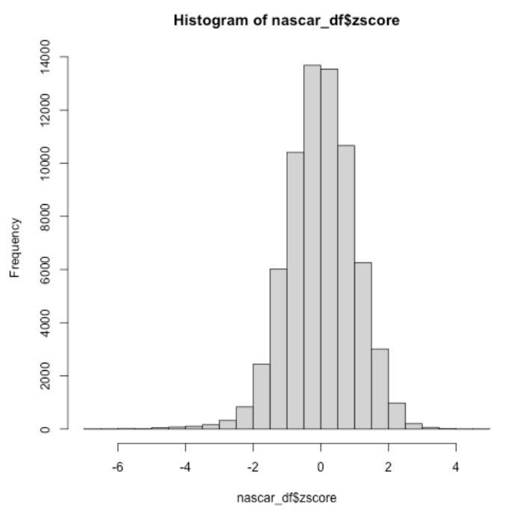
Summarizing the data variation

Slide 25
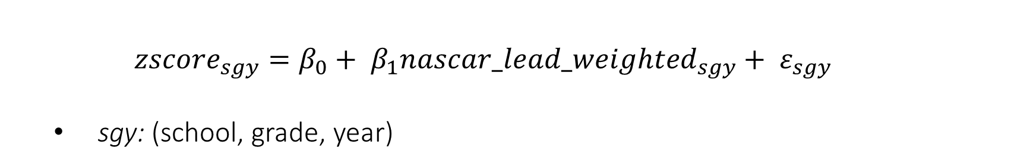
Let’s run the naïve regression…
$${zscore}_{sgy}=β_{0}+ β_{1}{nascar_lead_weighted}_{sgy}+ ε_{sgy}$$
sgy: (school, grade, year)

Slide 26
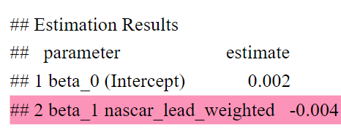

Let’s run the naïve regression…
$${zscore}_{sgy}=β_{0}+ β_{1}{nascar_lead_weighted}_{sgy}+ ε_{sgy}$$
sgy: (school, grade, year)
In words: “10 additional kg of lead exposure from nearby NASCAR races is associated with a school having an average test score 0.004 SDs lower.”

Slide 27
We know we can do better…
Schools near raceways are probably different than schools further away
We need to control for school attributes that are correlated with both test scores and being spatially close to a NASCAR race
Two variables in our data meet that standard:
Lead emissions from non-race sources (other_lead)
Median income in the school district (income)

Slide 28
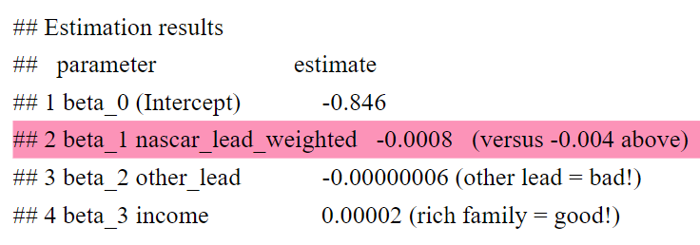

Let’s run the naïve regression…
$${zscore}_{sgy}=β_{0}+ β_{1}{nascar_lead_weighted}_{sgy}+β_{2}{other_lead}_{sgy}+β_{3}{income}_{sgy}+ε_{sgy}$$
Omitted variable bias: new estimate of $\hat{β_{1}}$ is only 20% of the naïve estimate’s magnitude
Do you find this estimate credible?

Slide 29
Bringing this back to the realm of quantifying monetary benefits…
Modelling required to quantify key benefit channel of reducing lead exposure:
Less lead -> Higher IQ -> Better schooling outcomes -> College attendance -> Higher lifetime wages

Slide 30
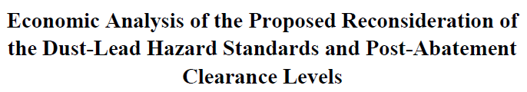

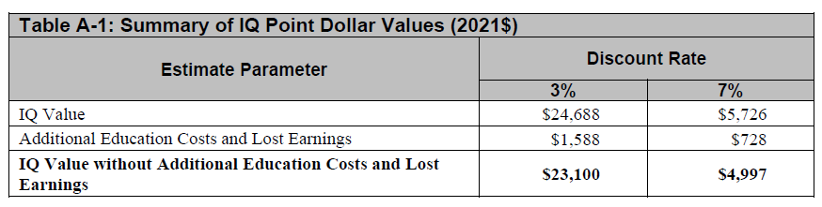
Bringing this back to the realm of quantifying monetary benefits…
Modelling required to quantify key benefit channel of reducing lead exposure:
Less lead -> Higher IQ -> Better schooling outcomes -> College attendance -> Higher lifetime wages

Slide 31
Environmental Econometrics
Econometrics used within the field of environmental economics is not inherently different than approaches used in other fields.

Slide 32
Environmental Econometrics
Econometrics used within the field of environmental economics is not inherently different than approaches used in other fields.
However, in many cases the research questions are different and, therefore, require different methods.

Slide 33
Environmental Econometrics
Econometrics used within the field of environmental economics is not inherently different than approaches used in other fields.
However, in many cases the research questions are different and, therefore, require different methods.
Because the research questions are different, environmental economists have advanced specific areas of econometrics to address hurdles that other fields may not face. In particular: econometric tools to estimate the value of nonmarket goods and services, specifically nonuse or nonlocal goods.

Slide 34
What is a nonmarket good?
“The problem of non-market valuation is to compute a monetary value for environmental resources or services that, in the general set up of market economies, are not subject to exchange, and therefore do not have an observable market price. For instance, we might be interested in knowing the monetary value of preserving a wooded area in an urban landscape, relative to area’s value in a residential use.”
- Phaneuf & Requate (2017)

Slide 35
Revealed preference approaches
“Revealed preference methods are based on the premise that, though there are no direct markets for some environmental goods, people interact with the environment in a variety of observable ways.
Through their participation in private good markets that interact with the environment, people often leave behind behavioral footprints that reveal information about their environmental preferences.”
Revealed preference methods are based on actual behavior reflecting utility maximization subject to constraints… we can infer monetary value “from observations of people acting in real-world settings where they must live with the consequences of their choices.”

Slide 36
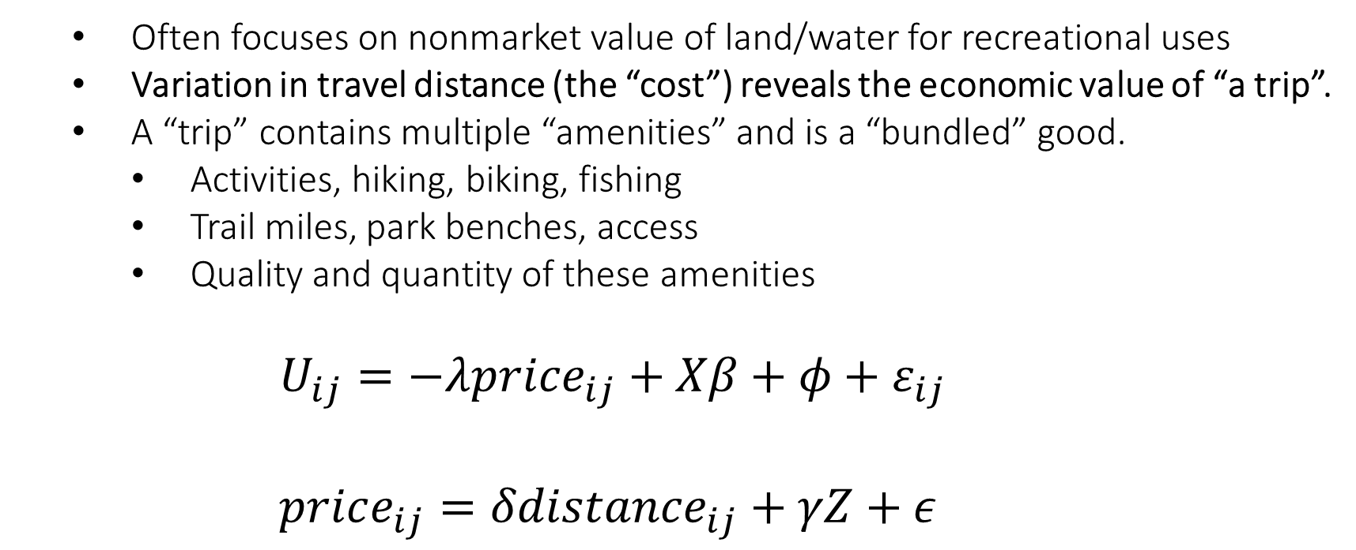
Travel Cost models
Often focuses on nonmarket value of land/water for recreational uses
Variation in travel distance (the “cost”) reveals the economic value of “a trip”.
A “trip” contains multiple “amenities” and is a “bundled” good.
Activities, hiking, biking, fishing
Trail miles, park benches, access
Quality and quantity of these amenities
$$U_{ij}=−λprice_{ij}+Xβ+φ+ε_{ij}$$
$$price_{ij}=δdistance_{ij}+γZ+ε$$

Slide 37
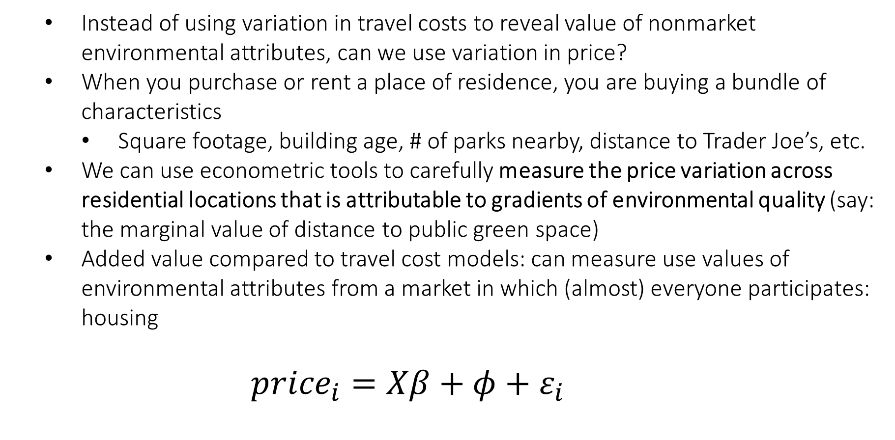
Hedonic Valuation
Instead of using variation in travel costs to reveal value of nonmarket environmental attributes, can we use variation in price?
When you purchase or rent a place of residence, you are buying a bundle of characteristics
Square footage, building age, # of parks nearby, distance to Trader Joe’s, etc.
We can use econometric tools to carefully measure the price variation across residential locations that is attributable to gradients of environmental quality (say: the marginal value of distance to public green space)
Added value compared to travel cost models: can measure use values of environmental attributes from a market in which (almost) everyone participates: housing
$${price}_{i}=Xβ+φ+ε_{i}$$

Slide 38
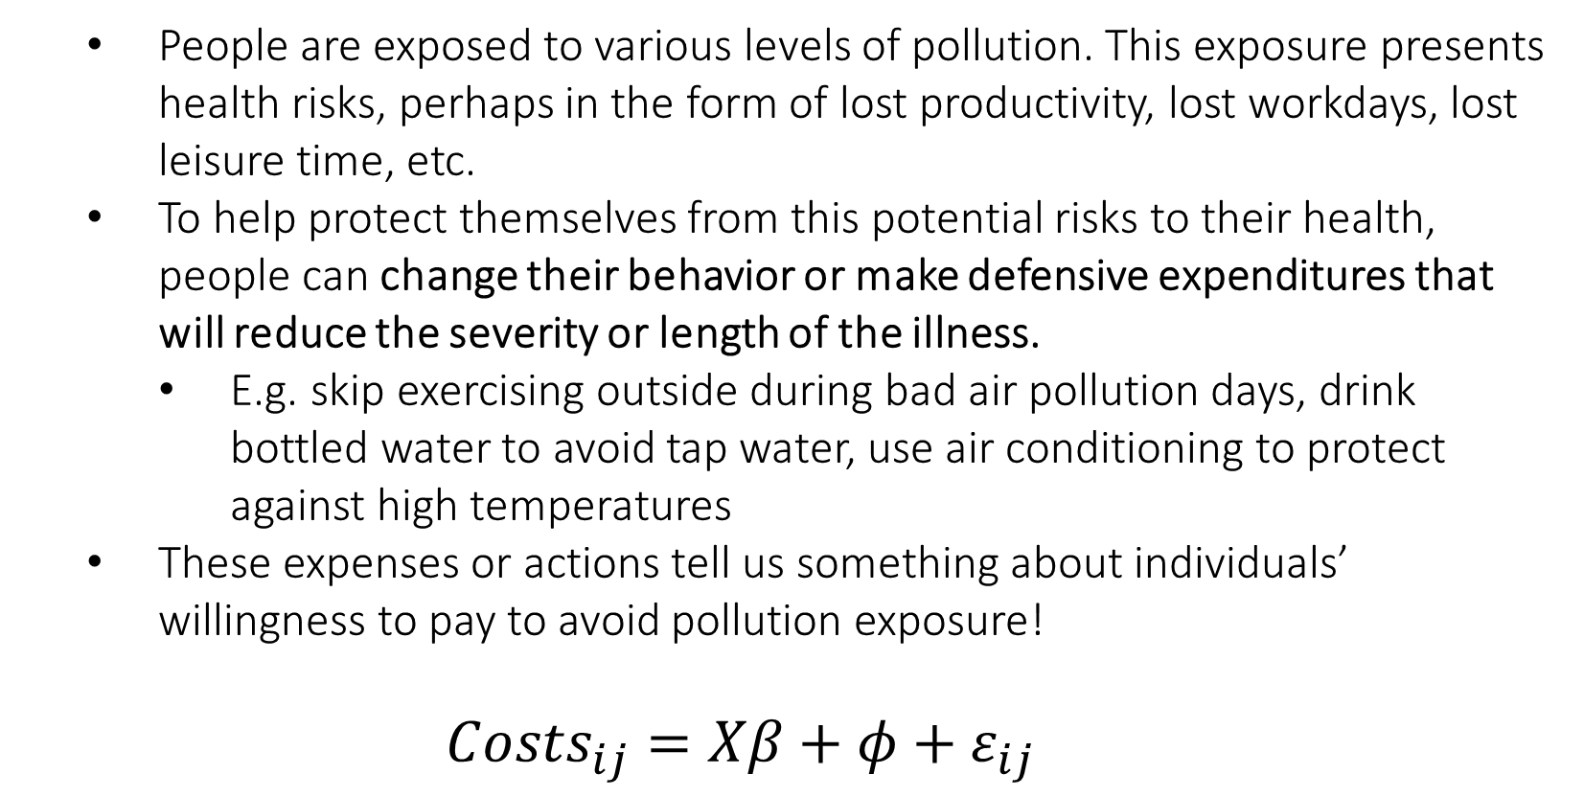
Averting Behavior / Defensive Expenditures
People are exposed to various levels of pollution. This exposure presents health risks, perhaps in the form of lost productivity, lost workdays, lost leisure time, etc.
To help protect themselves from this potential risks to their health, people can change their behavior or make defensive expenditures that will reduce the severity or length of the illness.
E.g. skip exercising outside during bad air pollution days, drink bottled water to avoid tap water, use air conditioning to protect against high temperatures
These expenses or actions tell us something about individuals’ willingness to pay to avoid pollution exposure!
${Costs}_{ij}=Xβ+φ+ε_{ij}$

Slide 39
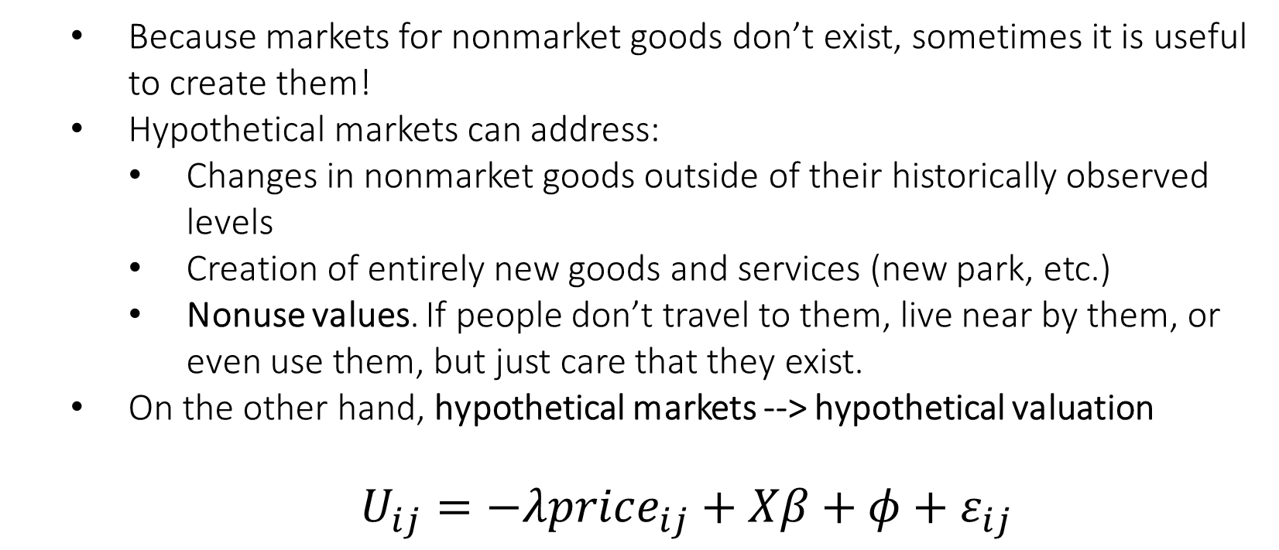
Stated preference approaches
Because markets for nonmarket goods don’t exist, sometimes it is useful to create them!
Hypothetical markets can address:
Changes in nonmarket goods outside of their historically observed levels
Creation of entirely new goods and services (new park, etc.)
Nonuse values. If people don’t travel to them, live near by them, or even use them, but just care that they exist.
On the other hand, hypothetical markets --> hypothetical valuation
$U_{ij}=−λprice_{ij}+Xβ+φ+ε_{ij}$

Slide 40
In practice: econometrics in the environmental realm
Linking research questions to econometric approaches requires careful thought about what the question is, what you believe the answer might look like, and the available data.
To best address a research question, start by thinking about what the “ideal” data might look like. Learning how “real-world” data compares to the “ideal” data often guides the approach that should be taken
Lastly, think about unique events that happen in our everyday lives that act as natural experiments. Did something occur suddenly and without expectation? Do states have very different policies while the communities on either side of the border remain the same?

Slide 41
Reminders
Reflection Post #1 due Sunday @ 11:59pm
Tomorrow: Travel Cost model. Be ready to discuss Hanauer & Reid (“Valuing urban open space using the travel-cost method and the implications of measurement error”)
Optional reading: Gellman, Walls, & Wibbenmeyer (“Welfare Losses from Wildfire Smoke: Evidence from Daily Outdoor Recreation Data”)

Slide 42
On reading academic econ articles…
As we discuss nonmarket valuation (and going forward, env. policy), will rely on research as illustrative case studies
Each class we will be reviewing articles, their methods, and their conclusions
For those with less previous exposure: academic economics articles may require a bit of a learning curve
But there is a lot of great advice out there on how to best get started.
How to Read Journal Articles like a Professor

